Slide 1
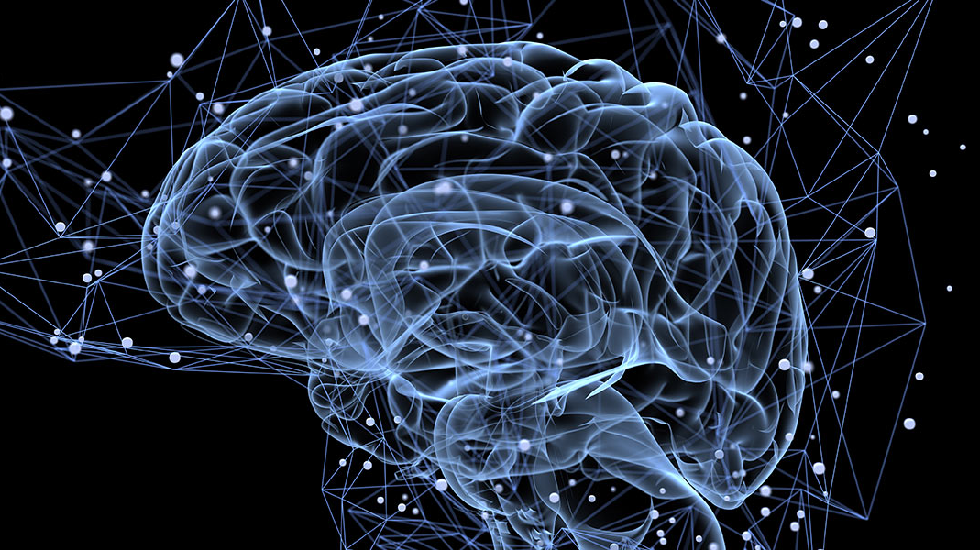
Is There Something Out There? Inferring Space from Sensorimotor Dependencies
Youness Kaddar, Kexin Ren
Philipona, D., O'Regan, J. K., & Nadal, J. P. (2003). Is there something out there? Inferring space from sensorimotor dependencies. Neural computation, 15(9), 2029-2049.

Slide 2
Content
Introduction
Reproduction Of Paper
Go Beyond Paper
Conclusion & Discussion

Slide 3
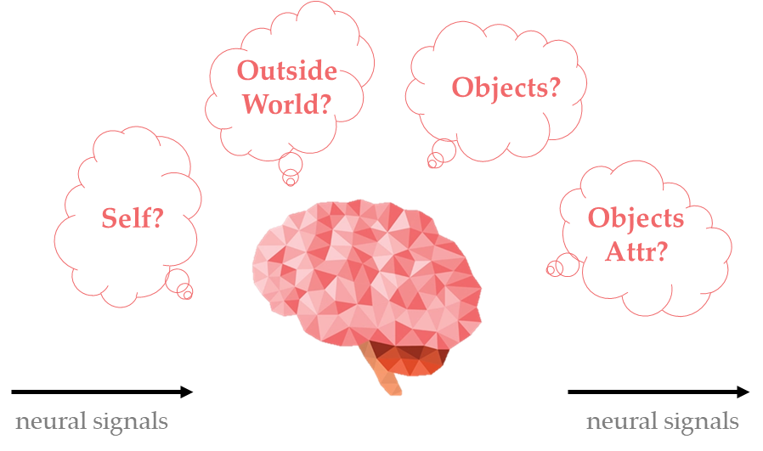
Introduction
Algorithms inside biological brains?

Slide 4
Introduction
?
Algorithms inside biological brains?

Slide 5
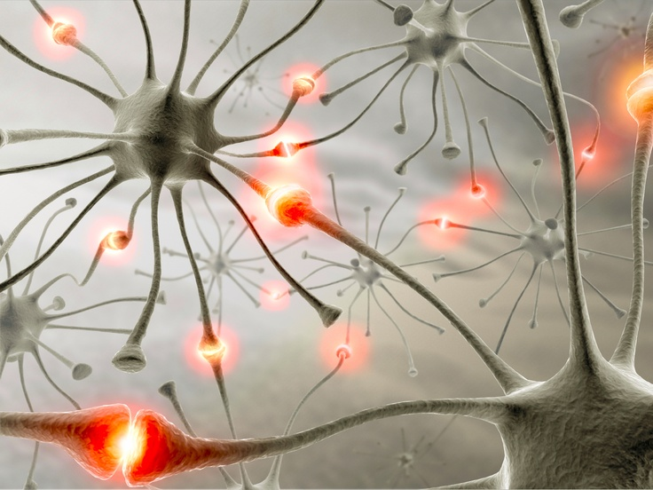
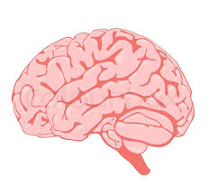
Introduction
Assumption
Naïve Brain
Brain has no info about
outside physical space
linkage btw. motor cmd & resultant motions
nerve pathways of sensors
Hypothesis
Brains continuously calculate neural activity stat in attempt to characterize it using a small number of parameters?
2
1
∅
Work in Paper

Slide 6
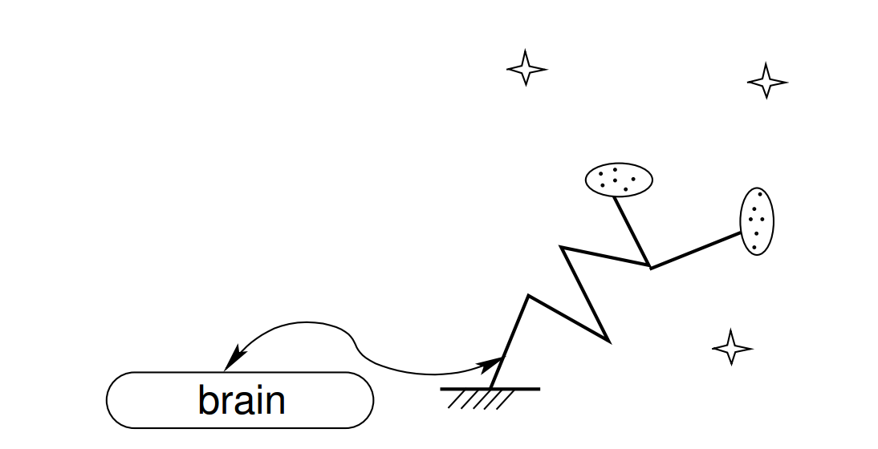
Introduction
lights
Approach
Basic idea: the basis of sensory experience consists extracting and exercising laws of sensorimotor dependencies
3
light-sensitive
sensors
joint position sensors
eyes
arm
A simple organism
Work in Paper

Slide 7
Introduction
partially ctrl
Results
Organisms can deduce:
limits of organism body
geometry & dimensionality of space outside organism
w/t priori knowledge, from the laws linking the brain’s inputs and outputs.
4
completely ctrl
random motor cmd
Work in Paper

Slide 8
Introduction
environment
Results
Organisms can deduce:
limits of organism body
geometry & dimensionality of space outside organism
w/t priori knowledge, from the laws linking the brain’s inputs and outputs.
4
body
random motor cmd
Work in Paper

Slide 9
Introduction
environment
Exteroceptive
input
Results
Organisms can deduce:
limits of organism body
geometry & dimensionality of space outside organism
w/t priori knowledge, from the laws linking the brain’s inputs and outputs.
4
body
proprioceptive
input
random motor cmd
Work in Paper

Slide 10
Introduction
(rep.of env.)
Exteroceptive
input
Results
A simple procedure for distinction btw. body & outside world
A simple algorithm for characterizing #variables necessary to describe organism’s body
Brain can deduce dim of outside physical space and #additional nonspatial parameters needed to describe attr. of objects/entities within it
pos of 3 lights
4
40
photoceptors
env. change / motor cmd
Work in Paper

Slide 11
Introduction
env. change
Exteroceptive
input
Results
Organisms can deduce:
limits of organism body
geometry & dimensionality of space outside organism
w/t priori knowledge, from the laws linking the brain’s inputs and outputs.
4
body change
motor cmd
Work in Paper

Slide 12
Introduction
COMPENSATION
env. change
Exteroceptive
input
Results
Organisms can deduce:
limits of organism body
geometry & dimensionality of space outside organism
w/t priori knowledge, from the laws linking the brain’s inputs and outputs.
4
body change
motor cmd
Work in Paper

Slide 13
Introduction
COMPENSATION
Results
Organisms can deduce:
limits of organism body
geometry & dimensionality of space outside organism
w/t priori knowledge, from the laws linking the brain’s inputs and outputs.
4
body & env. in single entity = space
Work in Paper

Slide 14
Introduction
COMPENSATION
Results
Organisms can deduce:
limits of organism body
geometry & dimensionality of space outside organism
w/t priori knowledge, from the laws linking the brain’s inputs and outputs.
4
Compensated transformations of body-env system
→ Geometry info
Work in Paper

Slide 15
Introduction
Conclusion
Organisms can deduce:
limits of organism body
geometry & dimensionality of space outside organism
w/t priori knowledge, from the laws linking the brain’s inputs and outputs.
5
Work in Paper

Slide 16
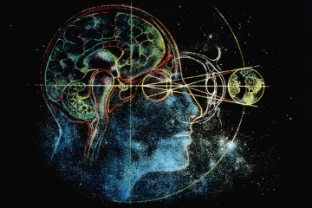

(just materials)
Outside
World?
Objects?
Self?
Objects
Attr?
neural signals
neural signals

